Slide 1
Session 6
A* search
(Minimizing the total estimated solution cost)

Slide 2
Session Outcomes
Student will learn the general-purpose informed (heuristic) search algorithm, A* that can be used to solve search problems.

Slide 3
A* search (Best-first search)
For Minimizing the total estimated solution cost
It evaluates nodes by combining g(n), the cost to reach the node, and h(n), the cost to get from the node to the goal: f(n) = g(n) + h(n) .
Since g(n) gives the path cost from the start node to node n, and h(n) is the estimated cost of the cheapest path from n to the goal, we have f (n) = estimated cost of the cheapest solution through n .
If we are trying to find the cheapest solution, a reasonable thing to try first is the node with the lowest value of f(n)=g(n) + h(n).
The algorithm is identical to GBFS except that A* uses g + h instead of h.

Slide 4
A* search (Continued…)
Algorithm:
Start with OPEN containing only initial node. Set that node’s g(n) value to 0, its h(n) value to whatever it is, and its f(n) value to h+0 or h(n). Set CLOSED to empty list.
Until a goal node is found, repeat the following procedure:
If there are no nodes on OPEN, report failure.
Otherwise pick the node on OPEN with the lowest f(n) value. Call it BESTNODE.
Remove it from OPEN. Place it in CLOSED.
See if the BESTNODE is a goal state. If so exit and report a solution.
Otherwise, generate the successors of BESTNODE but do not set the BESTNODE to point to them yet.

Slide 5
A* search (Continued…)
3. For each of the SUCCESSOR, do the following:
Set SUCCESSOR to point back to BESTNODE.
(These backwards links will make it possible to recover the path once a solution is found.)
Compute g(SUCCESSOR) = g(BESTNODE) + the cost of getting from BESTNODE to SUCCESSOR
c. See if SUCCESSOR is the same as any node on OPEN. If so call the node OLD. See whether it is cheaper to get to OLD via its current parent or SUCCESSOR via BESTNODE by comparing their g values. If SUCCESSOR is cheaper, then reset OLD’s parent to point to BESTNODE, record the new cheaper path in g(OLD) and update f’(OLD).

Slide 6
A* search (Continued…)
If SUCCESSOR was not on OPEN, see if it is on CLOSED. If so, call the node on CLOSED OLD and add OLD to the list of BESTNODE’s successors.
Check to see if the new path is better. If so, set the parent link and g and f’ values appropriately.
We must propagate the improvements to OLD’s successors. OLD points to successors. Each successor, in turn, points to its successors, and so forth until each branch terminates with a node that either is still on OPEN or has no successors.

Slide 7
So to propagate the new cost downward, do a depth-first traversal of the tree starting at OLD, changing each node’s g value (and thus also its f’ value), terminating each branch when you reach either a node with no successor or a node to which an equivalent or better path has already been found.
If SUCCESSOR was not already on either OPEN or CLOSED, then put it on OPEN and add it to the list of BESTNODE’s successors.
Compute
f’(SUCCESSOR) = g(SUCCESSOR) + h’(SUCCESSOR)

Slide 8
A* search (Continued…)
Example:
A∗ search applied to map of Romania:
This figure in the next slide represents the intial map of Romania.
The values representing in red colour are heuristic values(i.e h(n)).
The values representing in silver colour are path cost values
i.e g(n).
The values representing in blue colour are f(n) values
i.e., f(n) = g(n) + h(n).

Slide 9
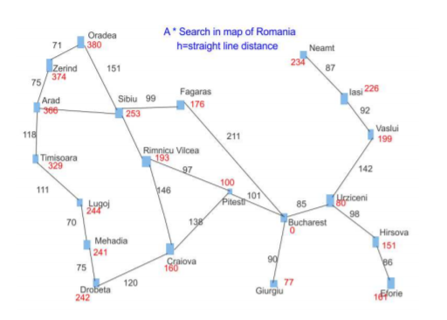
A* search (Continued…)
140
80
Initial map of Romania

Slide 10
A* search (Continued…)
After expanding Arad :
• We have three nodes i.e Zerind, Sibiu and Timisoara.
• As we know f(n)=g(n)+h(n).
• f(Sibiu)=f(n)=140+253=393 (g(n)=140 and h(n)=253).
•f(Zerind)=f(n)=75+374=449 (g(n)=75 and h(n)=374).
•f(Timisoara)=f(n)=118+329=447 (g(n)=118 and h(n)=329).
• From these nodes we have to choose the least f(n) value, so f(Sibiu) is least among these nodes.

Slide 11
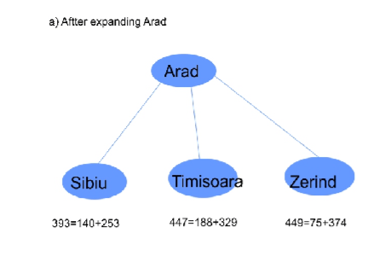
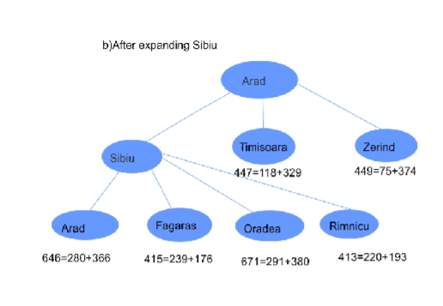

Slide 12
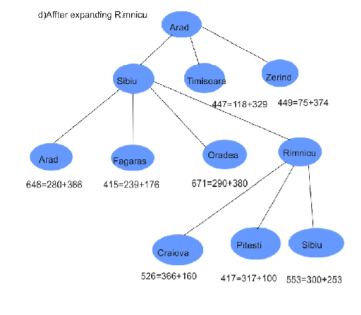

Slide 13
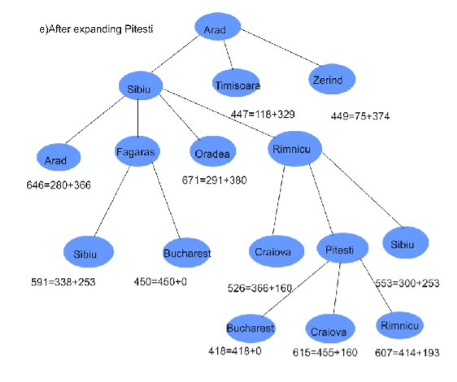

Slide 14
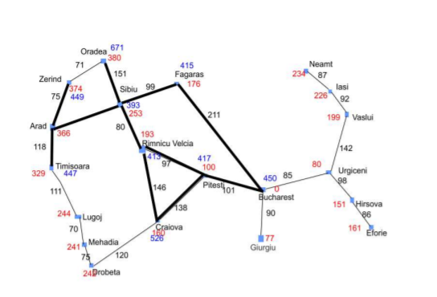
A* search (Continued…)
Nodes visited/Expanded

Slide 15
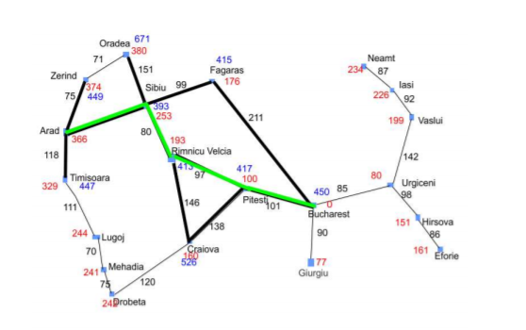
A* search (Continued…)
Shortest path from Arad to Bucharest

Slide 16
A* search (Continued…)
Advantages:
That A* search is complete, optimal, and optimally efficient among all such algorithms.
Disadvantages:
For most problems, the number of states within the goal contour search space is still exponential in the length of the solution.

Slide 17
A* search (Continued…)
That A* search is complete, optimal, and optimally efficient among all such algorithms.
Conditions for optimality:
Admissibility: The first condition we require for optimality is that h(n) be an admissible heuristic. An admissible heuristic is one that never overestimates the cost to reach the goal.
Consistency: A second, slightly stronger condition called consistency (or sometimes monotonicity) MCNOTONICITY is required only for applications of A* to graph search.

Slide 18
A
B
(3+1)
(4+1)
D
(5+1)
C
E
(3+2)
F
(3+3)
h’ underestimates h at node B

Slide 19
A
B
(3+1)
(4+1)
D
(5+1)
C
E
(2+2)
F
(1+3)
G
(0+3)
h’ overestimates h at node D

Slide 20
Observations about A*
F(n)=g(n)+h(n)
If g=0 then F(n)=h(n), then the node that seems closest to the goal will be chosen (and it becomes GBFS).
If g=1 and h=0 then the path involving fewest number of steps will be chosen.
If h=0 , then F(n)=g(n) then the search will be controlled by g (and it becomes uniform cost search).
If h=0 and g= 0 then the search strategy will be random.

Slide 21
MEMORY-BOUNDED SEARCH
(HEURISTIC SEARCH Technique) (Self Learning)
The simplest way to reduce memory requirements for A* is to adapt the idea of ITERATIVE DEPENING deepening to the heuristic search context, resulting in the iterative-deepening A* (IDA*) algorithm.
The main difference between IDA* and standard iterative deepening is that the cutoff used is the f-cost (g + h) rather than the depth; at each iteration, the cutoff value is the smallest f-cost of any node that exceeded the cutoff on the previous iteration.
IDA* is practical for many problems with unit step costs and avoids the substantial overhead associated with keeping a sorted queue of nodes.
Two memory bound algorithms are RBFS and MA*
End of Session

